Slide 1


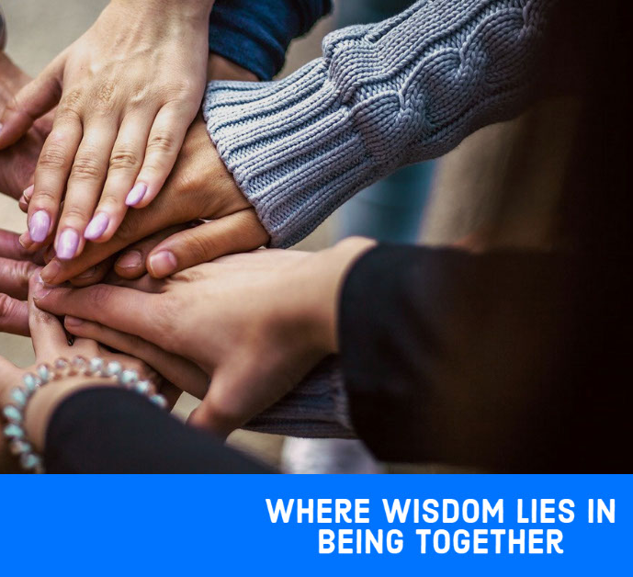
WEB SERVER APPLICATIONS Sprint 2 Project name: LangWiz
Prof. Mohamed Zeroug
Team: Albelis Gregoria Becea Marrero Jagrut Dipakkumar Gosai Rameswari Vipul Bhoi Gabriel Paz Paiva

Slide 2

About the Project

Slide 3
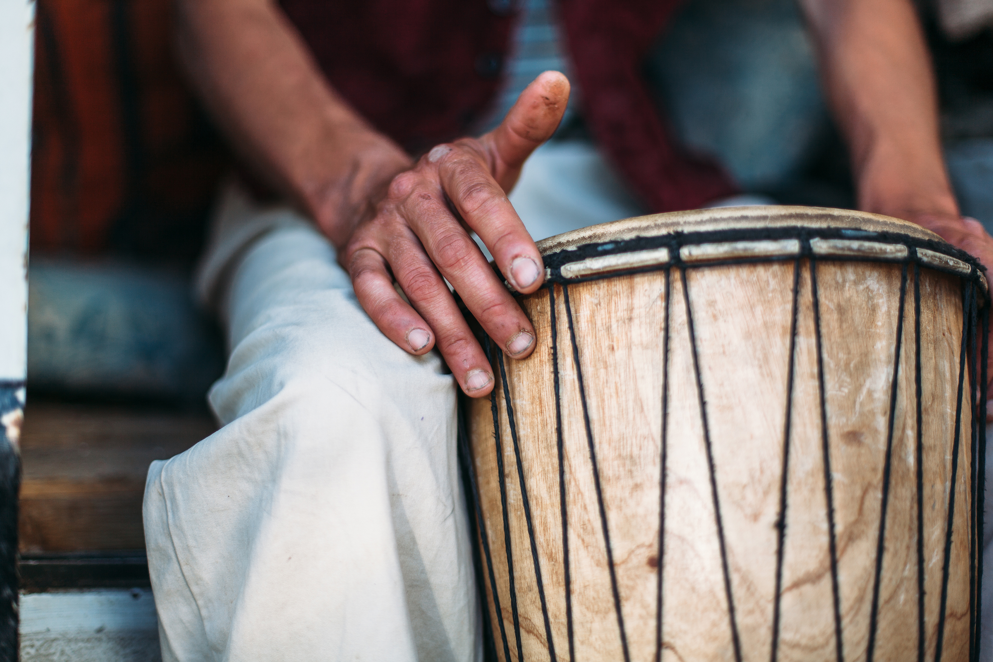


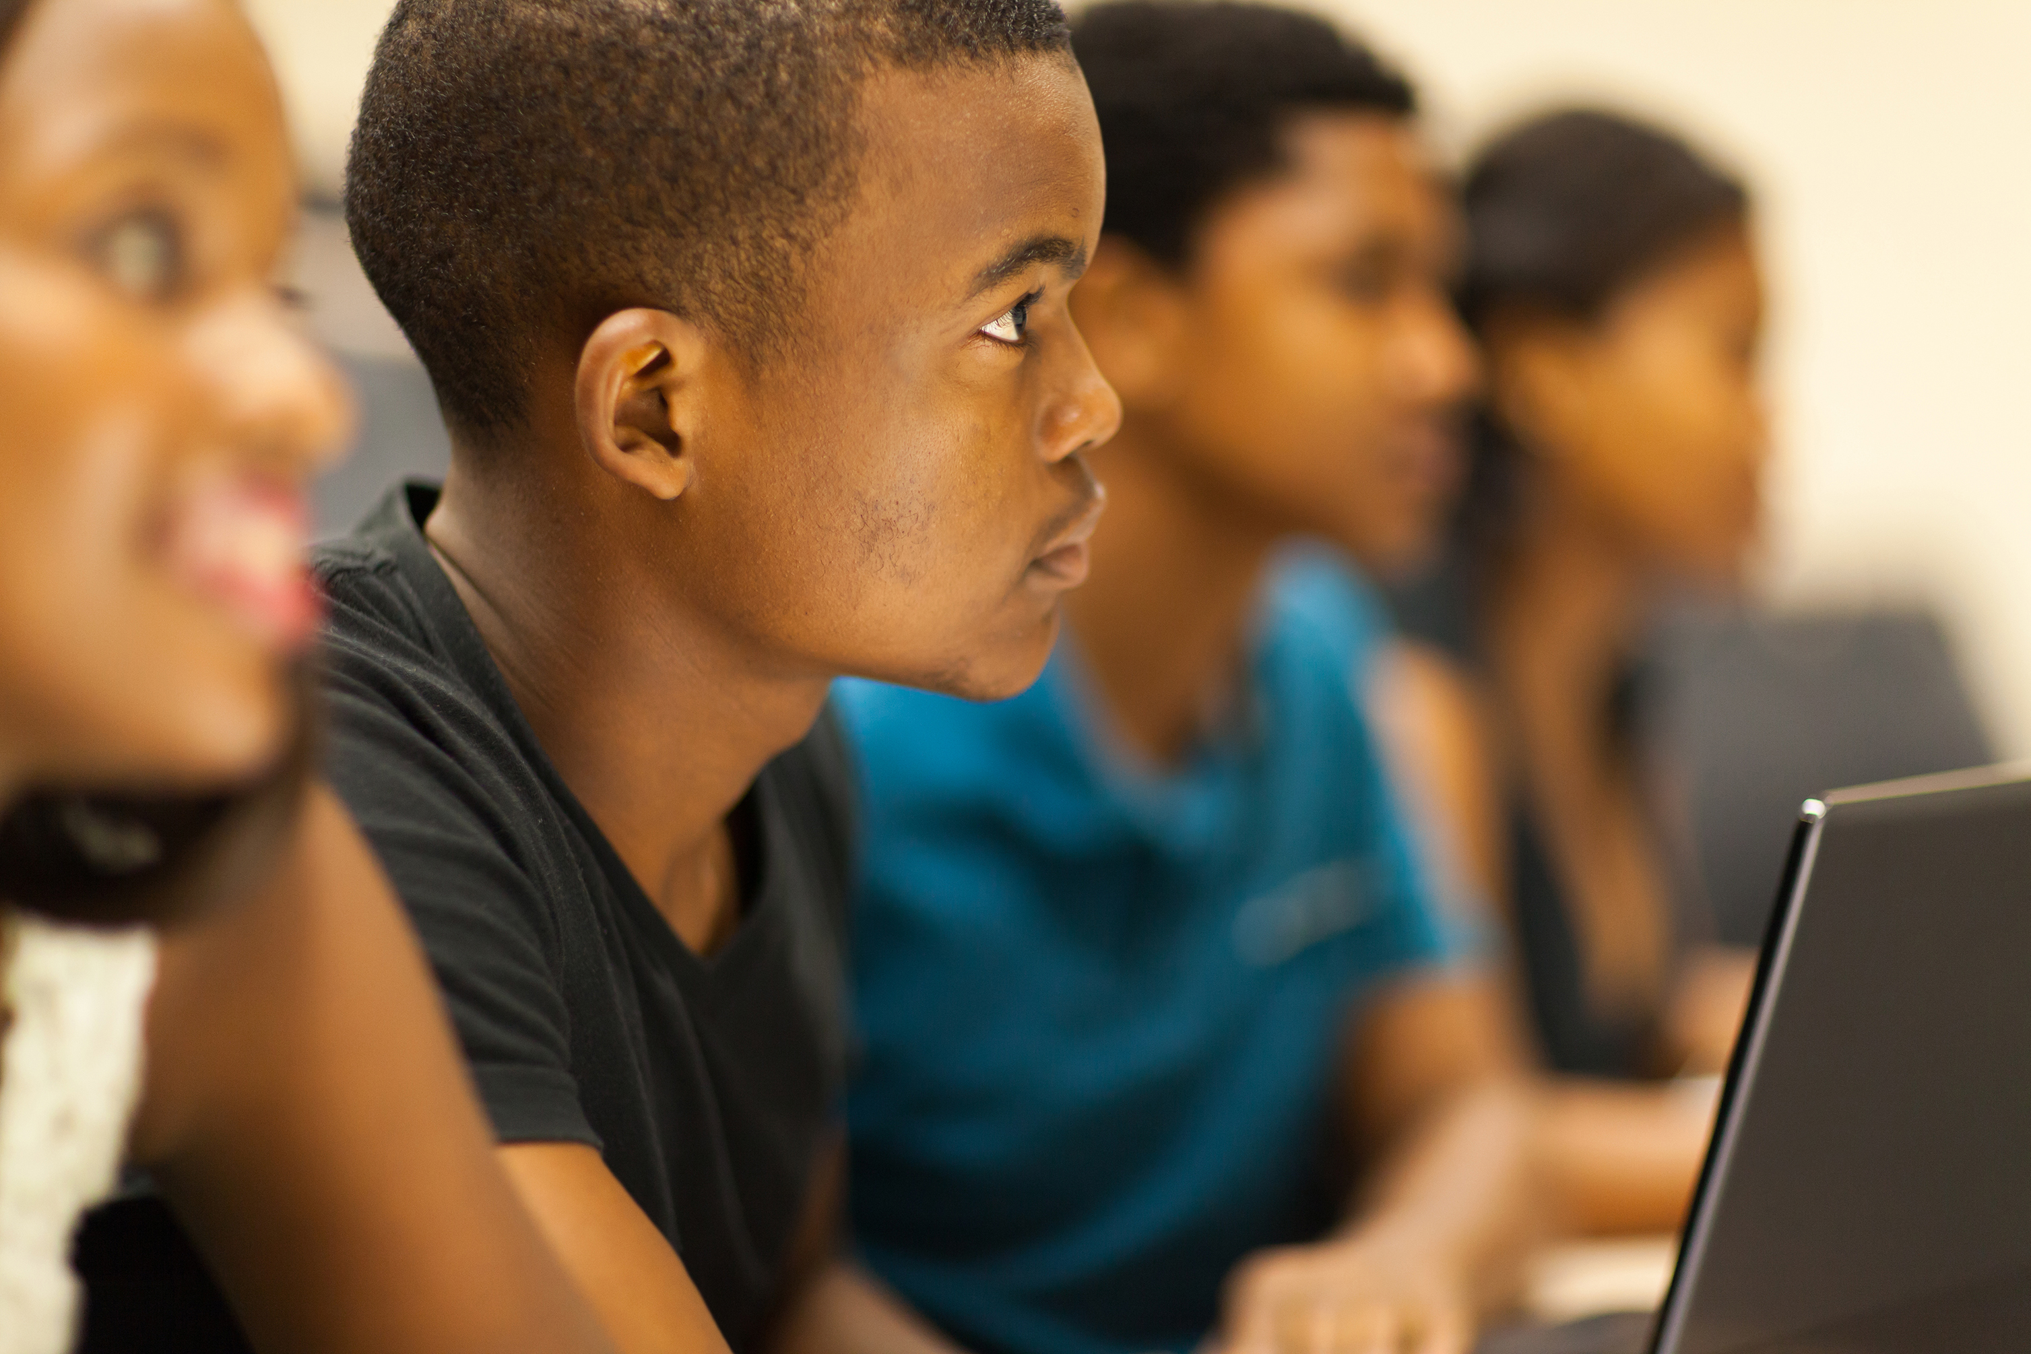
Quick reminder
Create a platform that allows people to learn at once and help each other.
Beyond the classroom, in LangWiz you can share experiences, culture, and hear first-hand the correct pronunciation of the language you want to learn.
Everyone have the opportunity of learn and connect with more people through technology.

Slide 4
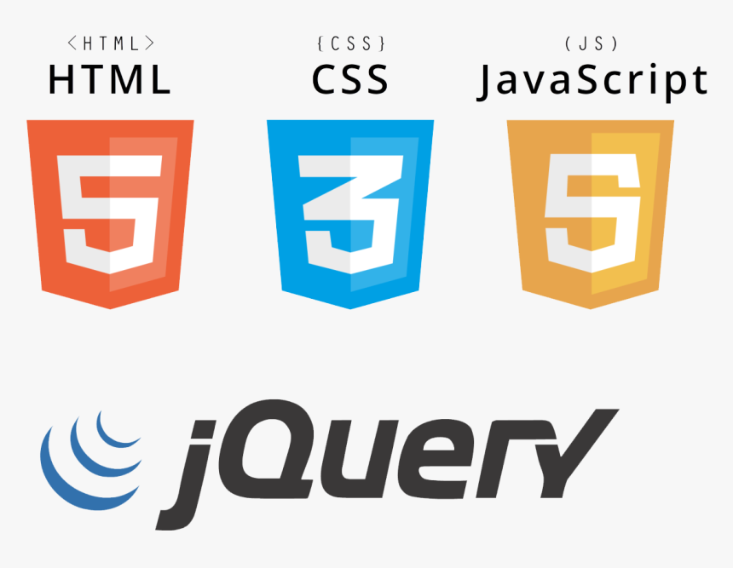








Tools

Slide 5
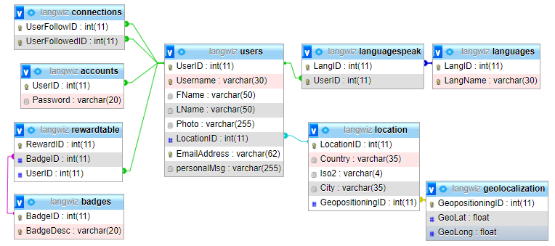
Database Design

Slide 6
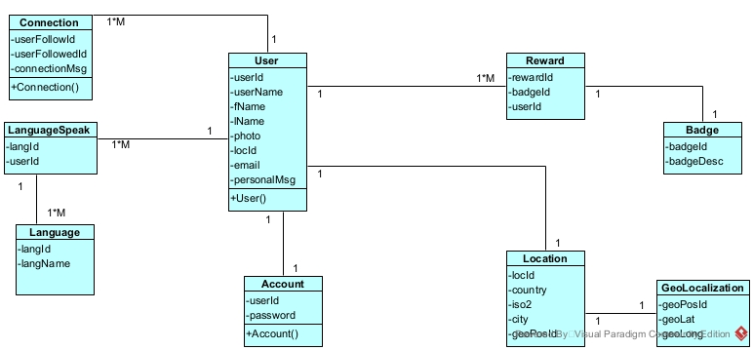
Class Diagram Goal

Slide 7
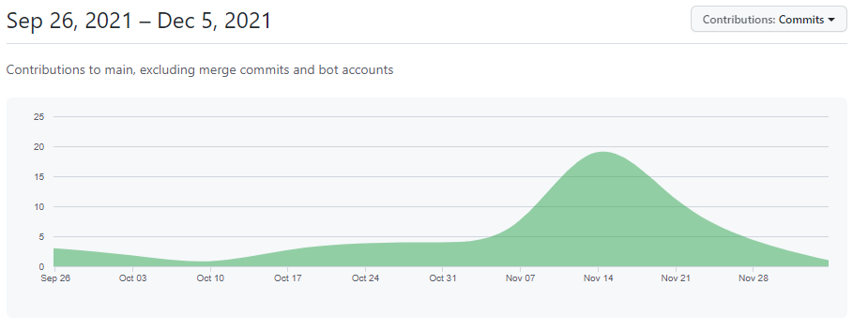

Development

Slide 8
Work Division
Albelis – FullStack
Gabriel – Back-End
Rameswari – Back-End
Jagrut - Design

Slide 9



Sprint goals
Access Management
Account creation (register and login).
Build Password Generator with Strength Checker using jQuery.
Login with Google Account.
Personalize profile.
Personalize user image by uploading JQuery and Ajax.
Post user personal message.
Rewarding System
Ranking list.
Give rewards for achievements.
Badge upgrading system.
Match management
Matching by specific criteria.
Unmatch to remove matches.
Matching by own algorithm.

Slide 10
Challenges
Google login
Integration between languages
Meeting's routine
Tasks distribution
Security

Slide 11
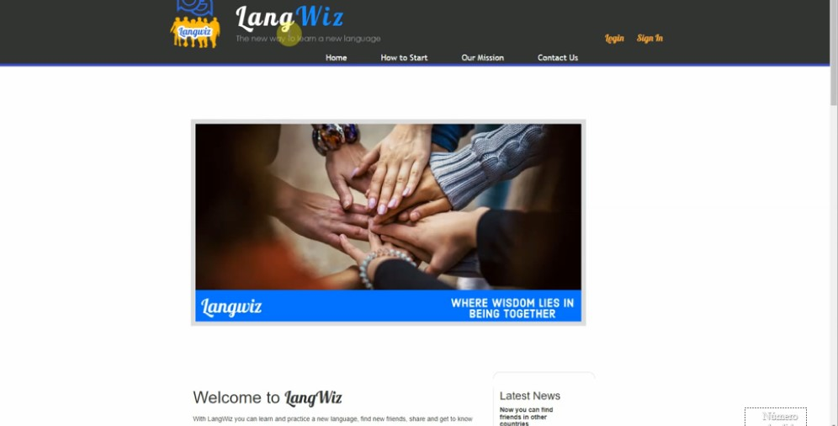
The Website

Slide 12
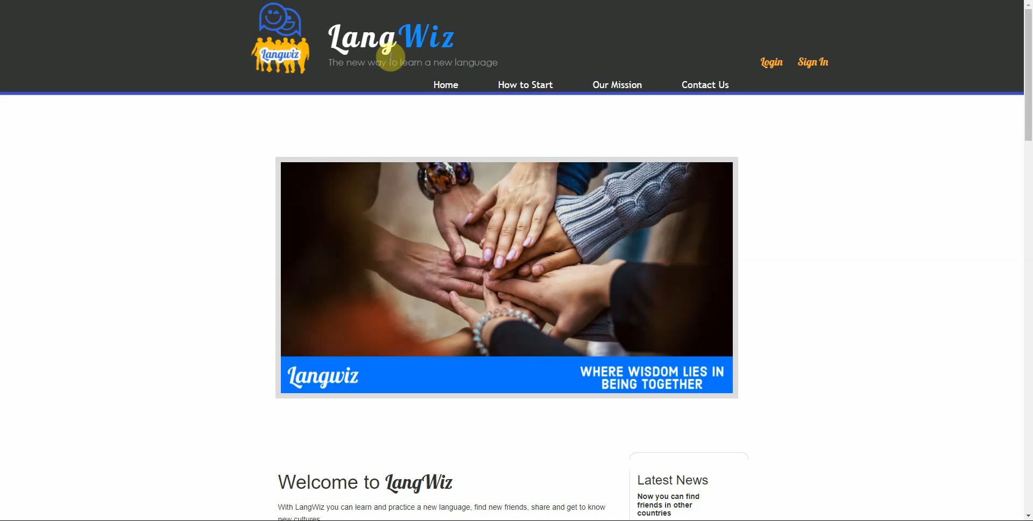

Slide 13
THANK YOU!

